Slide 2
Visit by dr. Sunada
06/10/22

Slide 3
Inhaltsverzeichnis
01
02
03
THW 連邦技術支援庁
The THW Training Center
THWリーダーシップトレーニングの例

Slide 4
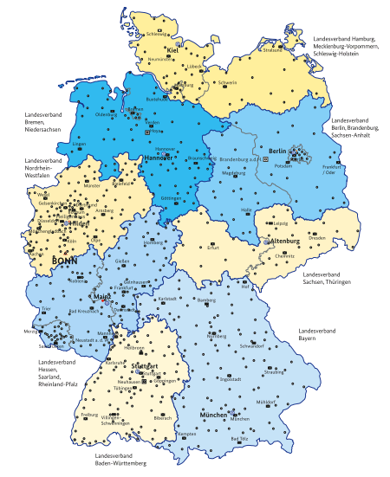





The Federal Agency for Technical Relief
01
The Federal Agency for Technical Relief
Structure
Die Acht THW-LV:
THW Management (Bonn, full-time staffed)
Training center (full-time staffed)
8 state associations (LV, full-time staffed)
66 regional offices (RSt, full-time staffed)
668 local chapters (OV, volunteer staffed)

Slide 5

Dates and facts (selected): annual report 2020
2020: 70 years THW
Volunteers: total: 79,927
of which youth: 15,377
of which women: 12,525
Hours of deployment: 1,124,398
Deployment focus „COVID“: Logistics, technical support, consulting
Full-time employees: 2,013 positions (↗)
Budget: 314.239m € (↗)
Misc 2020: Start of the „Federal Voluntary Service“ within the THW

Slide 6
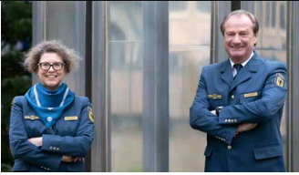
The Federal Agency for Technical Relief
The thw local chapter (OV)
668 within Germany – Structure:
Behördenleitung THW:
Sabine Lackner (VP)
Gerd friedsam (P)
Volunteer management (Head of Local Chapter )
Management staff
Technical advisors
Tactical units, usually 1 technical platoon
Veterans & senior group
Basic traning group
Youth group

Slide 7
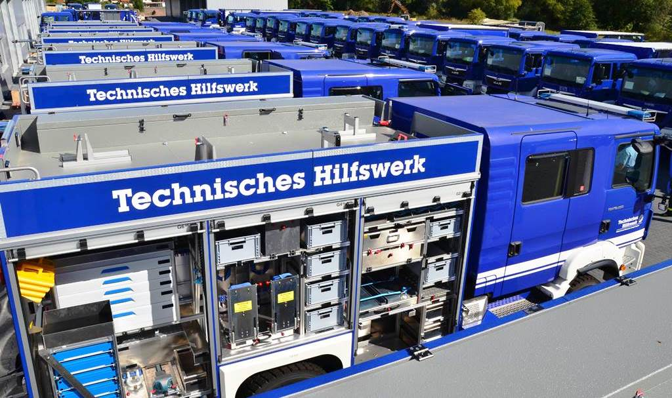
The Federal Agency for Technical Relief
Taktische Einheiten im thw
Technical platoons (TZ), 716x
    Each with basic component Command Squad (ZTr TZ) + Rescue Group (BGr)
    Other technical units possible: Bridge Building, Electricity Supply, Infrastructure, Emergency Supply and Maintenance, Search and Rescue, Oil Hazards, Debris Clearing, Demolition & Blastink, Drinking Water, Water Hazards, Water Damage & Pumping
    Occasionally technical squads: Work Site Security, Mobile Flood Gauge, Unmanned Aerial Vehicles
Command and communication platoon (FZ-FK), 66x
Logistics platoon (FZ-Log), 66x
Overseas rapid deployment units (SEEBA, SEEWA)
„Rolling toolbox“
Equipment vehicle (GKW)

Slide 8
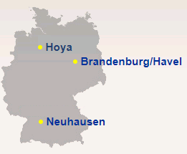
The thw training center
02
The thw training center
Structure
Management (Bonn)
Department A1 „Training Design/Development“ (Bonn)
Department A2 „Training Support“ (Bonn)
Training Center Hoya (Lower Saxony)
Training Center Neuhausen a. d. F. (Baden-Württemberg)
Training Center Brandenburg/Havel (Brandenburg)

Slide 9
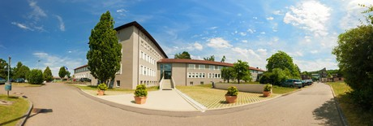
The Federal Agency for Technical Relief
Training Center
Neuhausen a. d. f.
Outline:
1995 transfer of the „Baden Württemberg State Disaster Management School“ to the THW – Name change to THW Federal School Neuhausen a. d. F.
Today:
Training group Command/Leadership
Training group Specialists
Training group Overseas
Seat of the „EU/UN Training and Support Center“
Statistics 2019:
255 Trainings with around 4,400 participants
140 special events with around 1,600 participants

Slide 10
Examples for trainings at the THW
Leadership training at the THW
Training Platoon Leader Technical Platoon
Training Advisor above district level

Slide 11
Examples for trainings at the THW
03
Management trainings at thw
Levels of training (simplified):
Basic training at the THW (at local level): Deployment readiness (incl. vaccinations)
Specialized training Technical unit/squad (at local level): Specialized/technical readiness
Training: Leadership basics, 1 week (AZ, classroom training)
Training: Specialized training Technical unit/squad, 1 week (AZ, classroom training
Training: Advanced training leadership, 1 week (AZ, classroom training)
Training: Platoon leader, Technical advisor
Training: Leading formations, Leading in control & command, Logistics leadership

Slide 12
Platoon leader of the technical platoon
Target audience:
Platoon leaders and command squad leaders of the technical platoon
Duration: 55 units (Mon–Sat)
Contents (selected):
      Legal basics
      Leading people/command squad management
      Deployment tactics/cooperation in civil protection / disaster mgmt
      Establishing and managing a platoon command post
Theoretical and practical exam

Slide 13
Examples for trainings at the THW
Advisor above district level
Target audience:
designated (technical) advisors up to local district level
Duration: 43 units (Mon–Fri)
Contents (selected):
  Legal basics, administrative structures, political structures, critical infrastr.
  Crisis and risk management and communication
  Simulation exercises on deployment options above local district level
Theoretical and practical exam

Slide 14
Thank you for your attention
Any questions?

