Slide 1
Donations
We are Certified as a public interest corporation by the Prime Minister. Any donation to Mobile Hospital International qualify for tax deduction under applicable local laws. Please donate with confidence. Your contribution is essential in helping us make progress towards this hospital ship program that will provide security and humanitarian assistance in Asia.
Sumitomo Mitsui Banking Corporation
SWIFT ： SMBC JP JT
Hibiya Branch/branch code: 632
Phone:+81-3-3591-8431
Account Number: 8635434
http://www.mobilehospital.org/donate/support/

Slide 2
Public Interest Incorporated Association
Mobile Hospital International
A public benefit corporation that has been granted on November 11th, 2011, in the authentication of the Prime Minister of Japan
http://www.mobilehospital.org/
info@mobilehospital.org

Slide 3
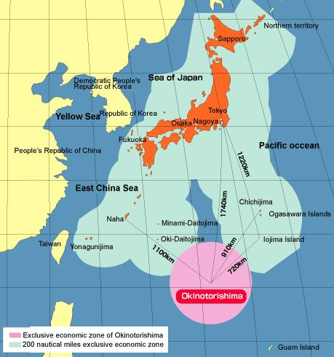
JAPAN
Japan's EEZ area: The world's sixth largest area of 4,470,000㎢
It is the 4th largest island country in the world and the largest island country in East Asia
Japan has the sixth longest coastline 29,751 km
Notes:
Point is to establish that Japan is surrounded by water from all sides & Japan should make use of this resource

Slide 4
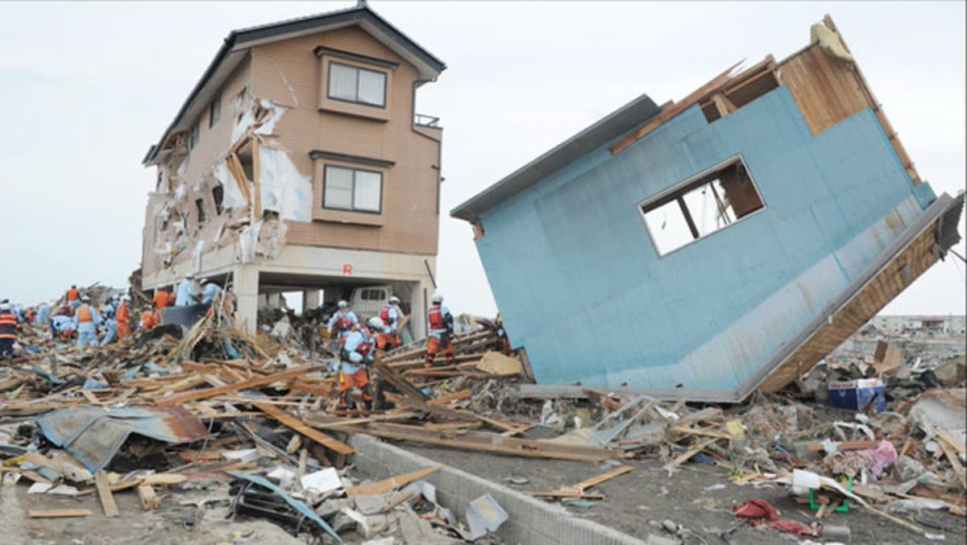
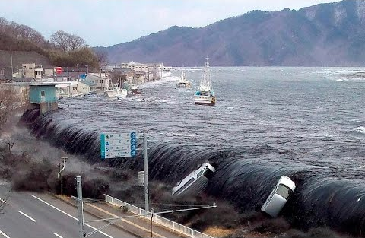
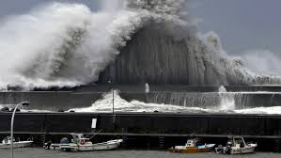
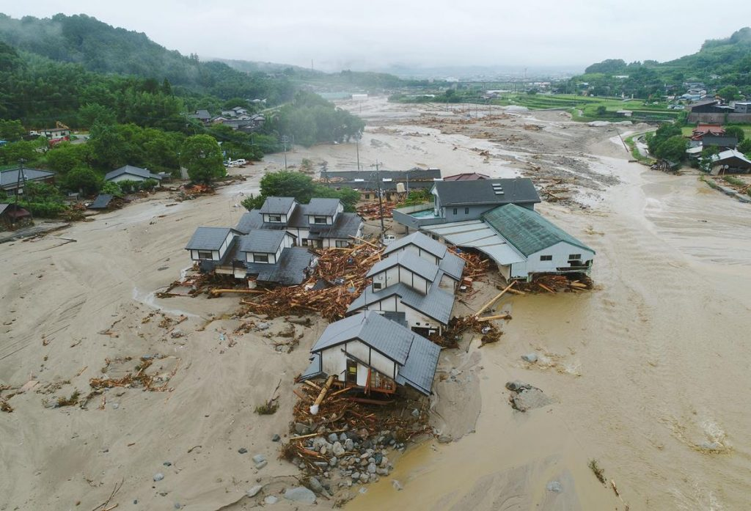
Natural Disasters in Japan
Earthquake
Tsunami
Typhoon
Floods
Notes:
Earthquakes, Typhoons & also smaller-scale natural disaster such as flooding, and landslides have continued to hit Japan every year. Traditional approaches to disaster response are not sufficient to face these ongoing challenges.

Slide 5
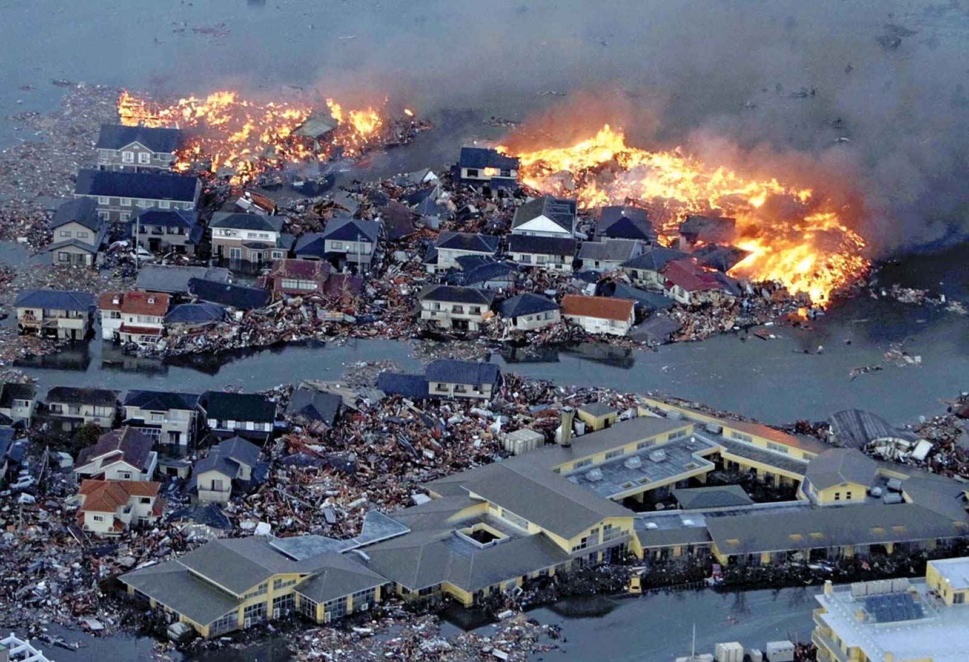
Restricted Access: Current Methods Not Applicable
Notes:
The earthquake and tsunami that struck eastern Japan on March 11,2013 devasted the medical functions of the three northern prefectures in Japan. The destruction and subsequent meltdown of the nuclear power plant in Fukushima Prefecture further compounded the situation restricting access to a large part of the disaster affected area. The current approach to disaster management relies excessively on road networks for access.
Japan is a maritime island

Slide 6
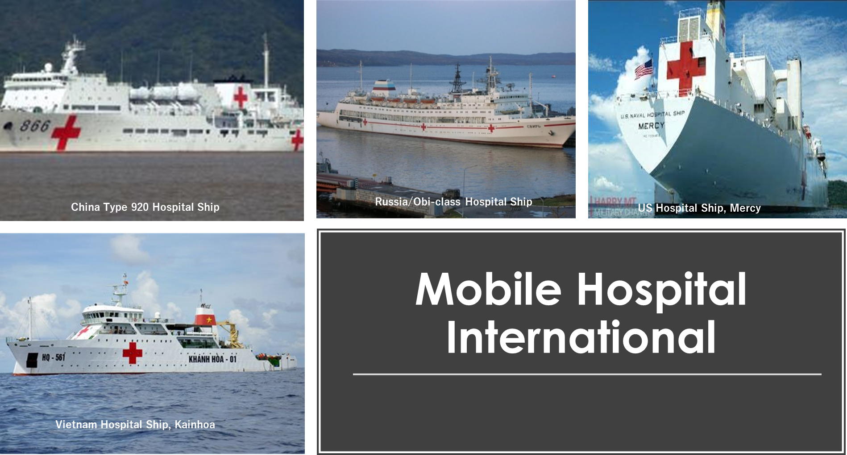
Notes:
Mobile Hospital International is the only Ngo established in Japan advocating for the construction of a hospital ship capability. Our members include prominent members of Japan's medical & business community. Together we are committed to achieving this goal to benefit Japan and the world.

Slide 7
Mobile Hospital International
http://www.mobilehospital.org/
In order to evacuate people safely in a large-scale disaster, the usefulness of the ocean approach cannot be ignored. We define disasters as follows:
Natural Disaster
Man-made disaster (Terrorism, etc.)
Special disasters (CBRNE disaster, etc.)
4. Infectious disease quarantine research and hospital ship design
In order to cope with these disasters, it is effective to deploy comprehensively from the sea by hospital ships with command and order centers and self-contained equipment.

Slide 8
Mobile Hospital International
http://www.mobilehospital.org/
Image Photo
ROLE OF HOSPITAL SHIPS IN TIMES OF DISASTER
Crisis Management Center (EOC) "offside center“ Support the functions of the disaster response from headquarters and from medical teams in prefectures and municipalities. Coordinate telemedicine support for the systematic introduction of people and things
The hardware (medical facility) and software (Medical personnel and medical equipment and drugs) will be deployed together in the disaster area within 72 hours.
Providing state-of-the-art medical facilities "OR and ICU at the disaster site“ to plant full-spec medical facilities in the disaster area that are not affected by the disaster.

Slide 9
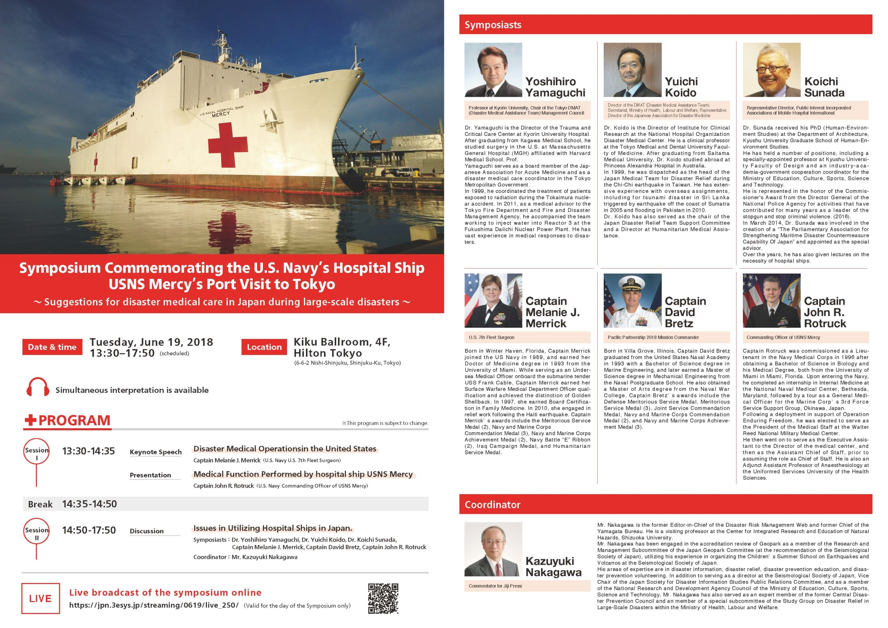

Slide 10
Let’s promote the legislation on development of a medical provision system utilizing ships in the event of disaster
Parliamentarian’s League for the future of Disaster Medicine in Japan

Slide 11
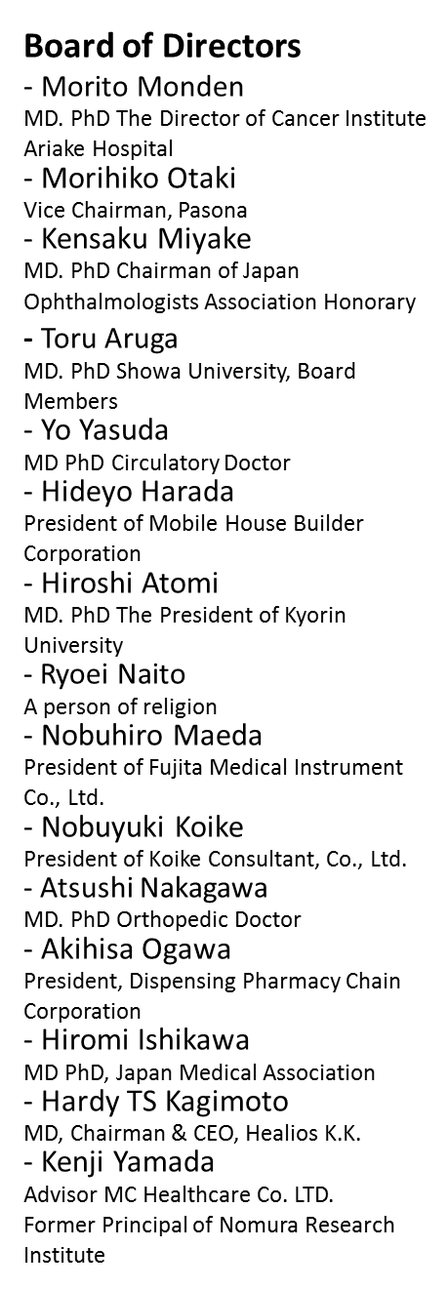
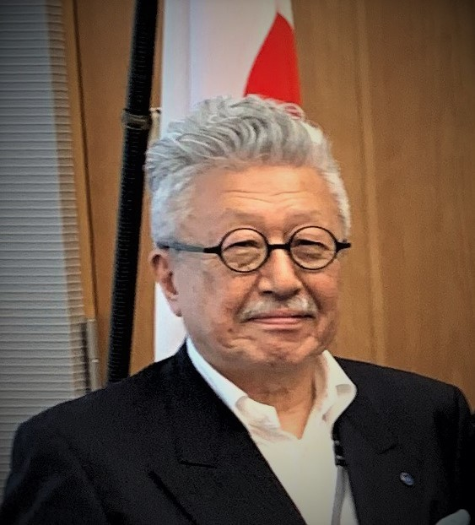
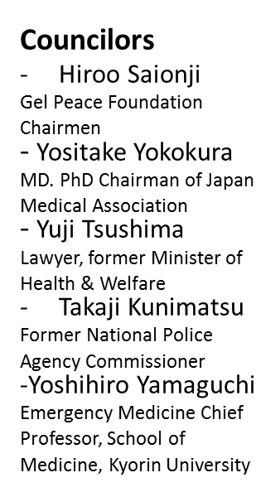
Mobile Hospital International: Team
http://www.mobilehospital.org/
Koichi Sunada, Ph.D.
Representative Director

Slide 12
We have built and produced a bipartisan federation to create new legislation.
`` Disaster Medical Vessel Utilization Promotion Union of the ruling and opposition coalitions ''
Main text of establishment
Japan is a disaster-prone country where large-scale earthquakes and tsunami disasters occur. Recent climate change is no exception in the Japanese archipelago. Severe disasters such as floods caused by large typhoons and collapse of houses due to landslides are increasing every year.
In order to be fully prepared for the Nankai Trough Earthquake and the Tokyo Metropolitan Earthquake that will surely occur in the near future, it will be necessary to newly legislate a rescue system that intervenes in the stricken area with a strategic approach from the sea.
To that end, it will be necessary to pass legislative legislation at an early stage to provide comfortable evacuation facilities for victims who take advantage of the advantages of ships and to promote the establishment of a ship hospital system equivalent to a land-based hospital on board. This realization will promote the creation of multi-purpose vessels (hospital vessels) for disasters, which are a symbol of safety and security for the people, and strengthen the ability to respond quickly in the event of a disaster.
Feb/27/2020/ Founding General Assembly

Slide 13
Mobile Hospital International: Ambulance boat PJ
http://www.mobilehospital.org/
*Tokyo Fire Department Agreement: Sea Approach and Rescue Boat Empirical Study.
*Faculty of Collaborative Medicine: Teikyo University, Nippon Medical University, Kokushikan University, Kyorin University,
Showa University Koto Toyosu Hospital.
Disaster Countermeasures Utilizing the Bay Area Waterway in Koto Ward

Slide 14
Donations
We are Certified as a public interest corporation by the Prime Minister. Any donation to Mobile Hospital International qualify for tax deduction under applicable local laws. Please donate with confidence. Your contribution is essential in helping us make progress towards this hospital ship program that will provide security and humanitarian assistance in Asia.
Sumitomo Mitsui Banking Corporation
SWIFT ： SMBC JP JT
Hibiya Branch/branch code: 632
Phone:+81-3-3591-8431
Account Number: 8635434
http://www.mobilehospital.org/donate/support/

