Slide 1
Analytical Simulation for Acceptance of Maximum Serious Injuries that can be handled at Disaster Base Hospitals
Manabu Ichikawa
Department of Health Crisis Management
National Institute of Public Health
ichikawa.m.aa@niph.go.jp

Slide 2
Content
Simulation of SIP activity and damage estimation system
Simulation analysis on earthquake under the capital city
  Distribution of seriously injured patients outbreak and accommodation at disaster base hospital
  Distribution of patients who can not be accommodated at disaster base hospital
Consideration of medical support by approach from the sea
For the seismic intensity distribution and distribution of seriously injured patients, the data provided by research results of SIP are used.
The patient's accommodation is simulated assuming that the bed occupancy rate in peacetime is assumed to be 80% and patients occurred are accommodated in 20% vacant.
The patient to be transported means patient that needs to be transported to another medical institution because the disaster base hospital can not accommodate due to fully occupied beds.
The content of this presentation is based on research results of the SIP (Cross-ministerial Strategic Innovation Promotion Program) "Strengthening Resilient Disaster Prevention and Reduction Function" of "Integrated Science and Technology · Innovation Conference" (Administrative Corporation: JST).

Slide 3
Social Simulation
Areas that clarify social phenomena (economics, transportation, public health, crisis management, etc.) through simulation
Background of the simulation
  Use of computer simulation started in the 1960s.
  Diffusion in the 1990's by computer evolution
Purpose of simulation
  Understanding phenomena (as is) and
  anticipation / prediction (to be)
Simulation technology
  Mathematical analysis and study (classical method)
  Analysis and study by reproducing social phenomena in artificial society on computer
    Various methods such as geographic information analysis, network analysis, agent base, etc.
Not a discussion of hitting the probability xx%
・It may become xxxx.
・It may become yyyy.
are expressed by simulation.

Slide 4

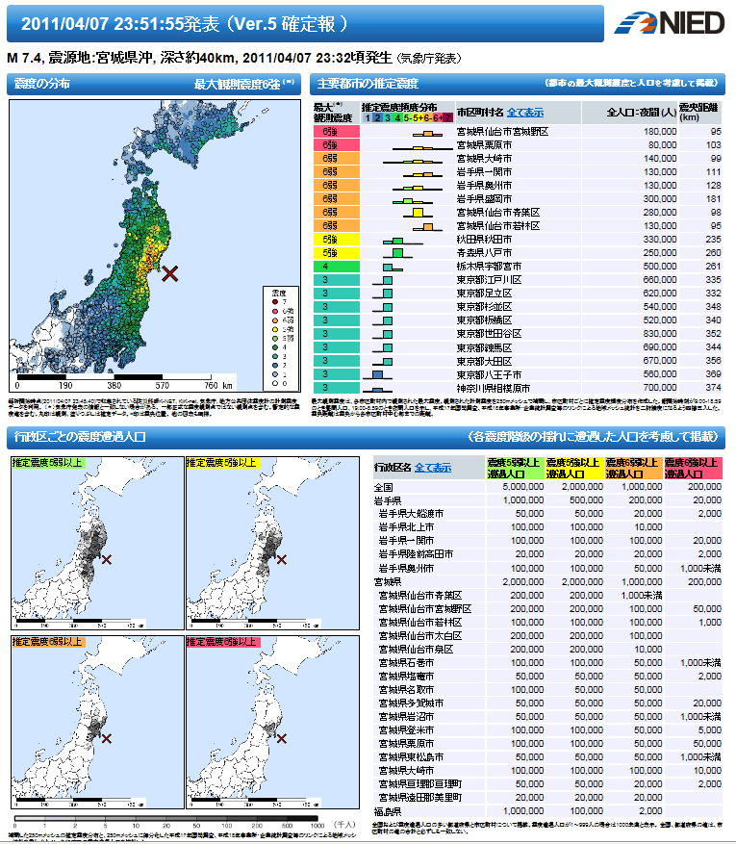





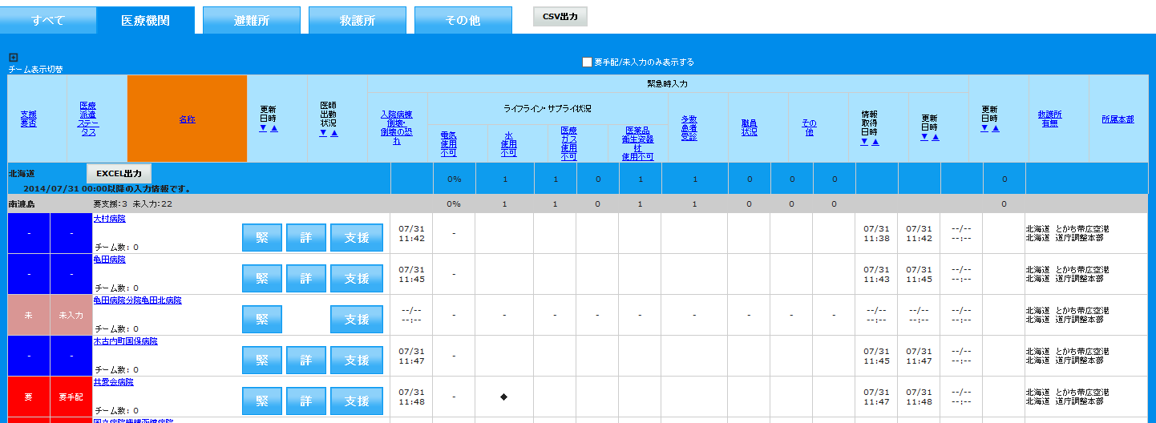
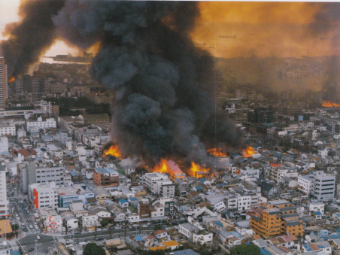
Strengthen logistic function for health care suporrt linked with SIP4D (Cross-ministerial information Sharing System)
Cabinet Office/Cross-ministerial Strategic Innovation Promotion Program
SIP Disaster Prevention Task 4MHLW G
Earthquake
information
Infrastructure information
Road information
……
……
……
……
……
……
Information Sharing
Realization of optimal relief activities
EMIS
Medical institution
information
Municipal disaster information
Transportation means information

Slide 5
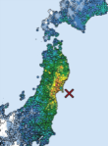
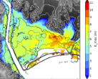
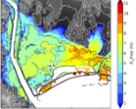


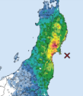
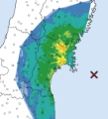
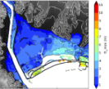
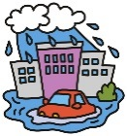





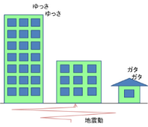
Development of real-time damage estimation and situation grasping technology and system
National Research Institute for Earth Science and Disaster Resilience
[Overview]
We will conduct technical development and system construction on high-precision real-time damage estimation and situation grasping aimed at providing secondary use information to support prompt and appropriate response through making the information overview by estimating the whole damage and grasping the situation in real time for the earthquake, tsunami and heavy rain, and making it available at town/chome or individual building level.
Cabinet Office/Cross-ministerial Strategic Innovation Promotion Program
SIP Disaster Prevention Task 5MHLW G
Real time damage estimation / situation grasping system
Real time damage estimation
Damage situation grasping
Nationwide
Incorporate information on the damage situation integrated by each government agency and relevant agency, finalize estimation information, grasp the damage situation
Earthquake
Tsunami/Heavy rain
250m mesh
Kanto/Tokai region
Detail/High Accuracy
Update estimation with real-time information continuously
Update estimation with real-time information continuously
Grasping situation
Target for model area
While overviewing the overall damage, make highly accurate estimations that can be used at town/chome, individual building level
Earthquake damage：Consider earthquake motion and building frequent characteristics
Finalizing estimation
Building damage estimation
Human damage estimation
Estimation
Tsunami/heavy rain flood damage
Earthquake observation data
Underground structure model
Building/population model
Tsunami / heavy rain
information and infrastructure
damage information
Regional cooperation
Information on damage
situation

Slide 6
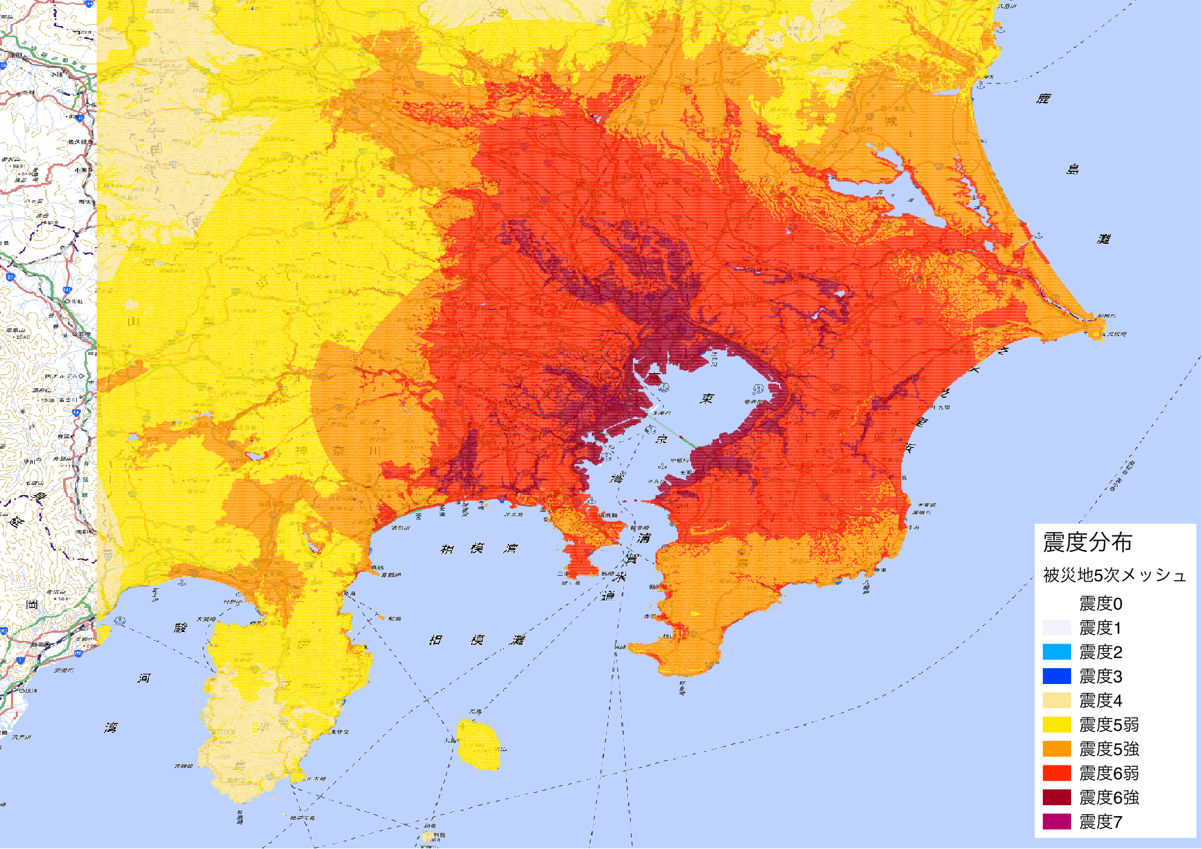
Earthquake under the Capital City（Damage Estimation）
Prefecture | Death toll | Number of serious injuries | Number of injured people
Chiba | 1,892 | 3,826 | 31,483
Saiama | 1,409 | 2,841 | 25,201
Kanagawa | 2,505 | 5,299 | 37,236
Tokyo | 4,637 | 7,073 | 50,230
Total | 10,443 | 19,039 | 144,150
Tokyo 23 wards | 4,131 | 6,112 | 40,963
Seismic intensity distribution
Disaster area 5th mesh
Seismic intensity 0
Seismic intensity 1
Seismic intensity 2
Seismic intensity 3
Seismic intensity 4
Seismic intensity 5⁻
Seismic intensity 5⁺
Seismic intensity 6⁻
Seismic intensity 6⁺
Seismic intensity 7
19,039 people seriously injured needs treatment at medical institution (estimated)
Seriously injured in Tokyo, concentrated in 23 wards

Slide 7
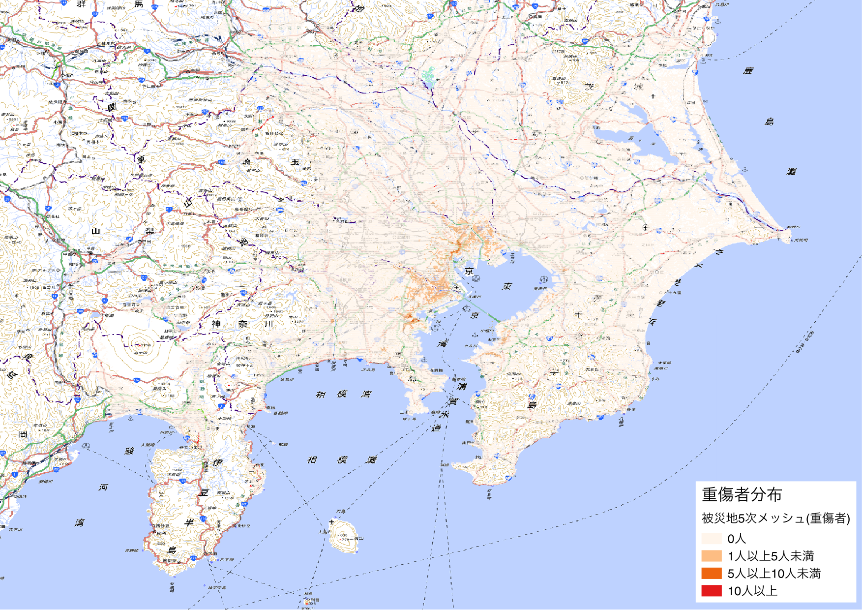
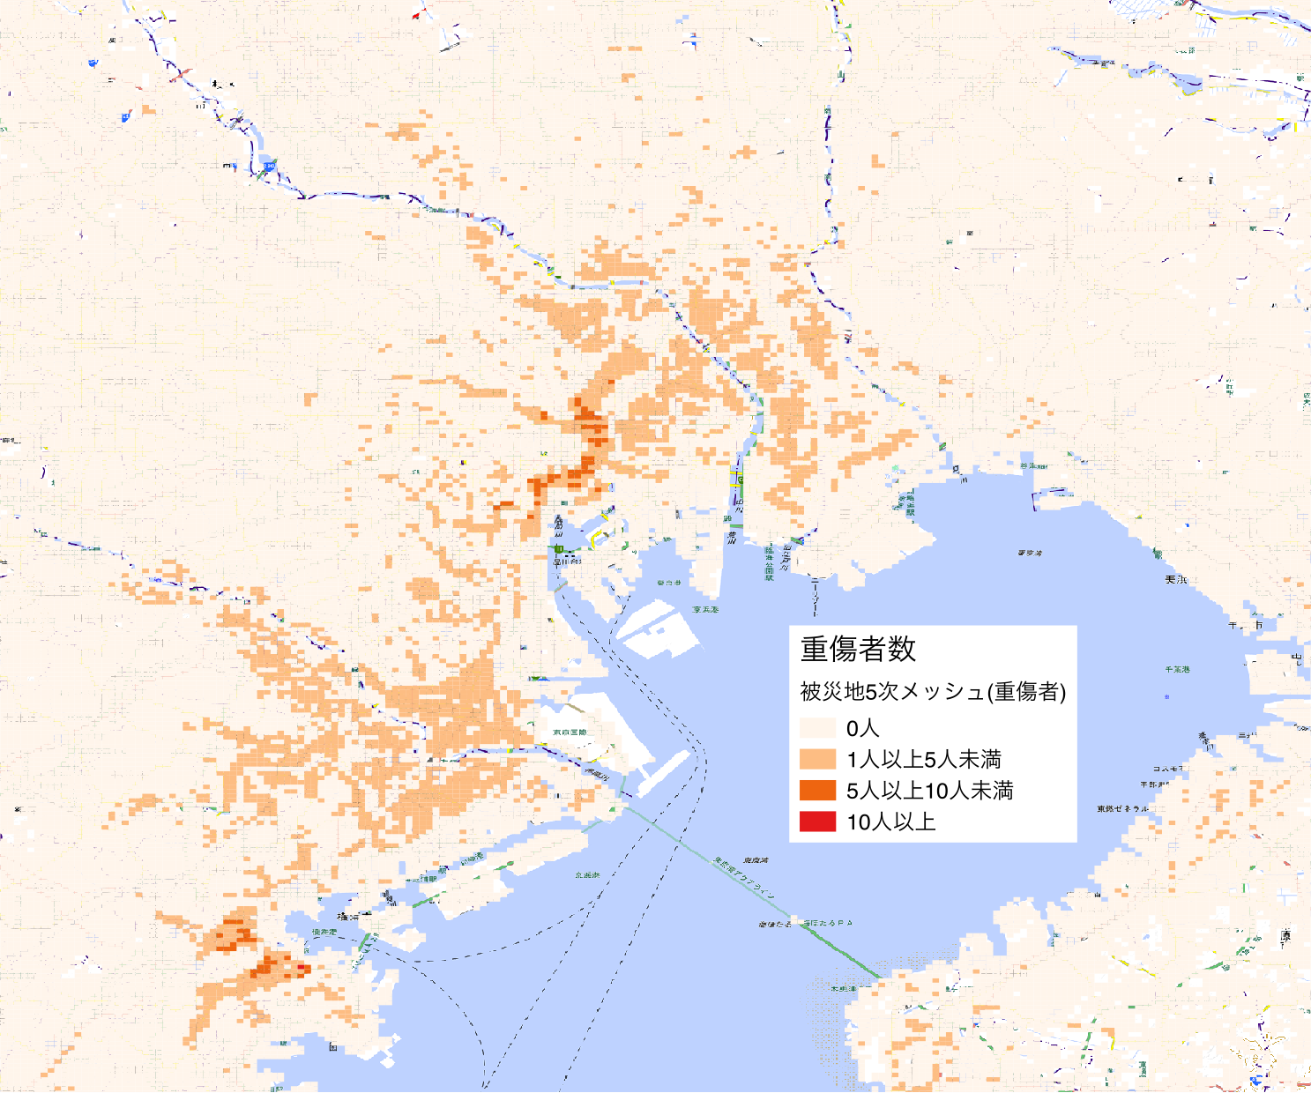
Earthquake under the Capital City（Distribution of Serious Injuries）
Areas with serious injuries
Tokyo 23 wards
Around Arakawa River
Chuo ward 〜Minato ward
Around Tamagawa River
Yokohama
Around Sakuragi Cho station
Around Kannai
station
Number of serious injuries
Disaster area 5th mesh (Serious injuries)
0 person
1 to 4 persons
5 to 9 persons
10 persons or more

Slide 8
Estimated Serious Injuries Movement at Disaster
To the nearest medical institution (ambulance, walking, private car, taxi, etc.)
  In case of calling an ambulance: Medical institute with emergency (primary emergency/ secondary emergency)
  In case of moving by themselves: The nearest medical
  institution
  Self-defense force may rescue and carry them to
  medical institutions
Patients who can not be received at disaster base
hospital
  DMAT gathers at disaster base hospital
  DMAT is responsible for transporting patients in disaster area
  Patient transportation between disaster base hospital, wide are transportation by air
For patients who can not be treated at medical institutions in the disaster area, transport to disaster base hospital and request DMAT support
Simulation of the supply of medical resources on the assumption that all serious patients that occurred in the disaster area were delivered to disaster hospitals
(Analyzed based on the maximum number of treating serious injuries at disaster base hospital)

Slide 9
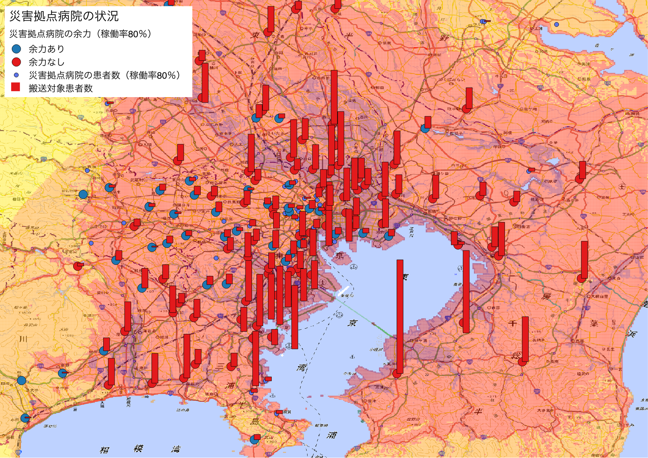

Comparison of the number of patients to be transported
Simulation 1: Miraculous situation
Simulation 2: Realistic situation
Disaster base hospitals all function
The road can be passed but there is traffic jam
Serious injuries of short-distance only move with vehicles
Disaster base hospitals all function
All roads are passable and there is no traffic jam
All serious injuries move by vehicle
Status of disaster base hospital
Reserve capacity of disaster hospitals (occupancy rate 80%)
Status of disaster base hospital
Reserve capacity of disaster hospitals (occupancy rate 80%)
With reserve capacity
Without reserve capacity
Number of patient at disaster base hospital (occupancy rate 89%)
Number of patients to be transported
With reserve capacity
Without reserve capacity
Number of patient at disaster base hospital (occupancy rate 89%)
Number of patients to be transported
It is issue for disaster hospitals to be able to accommodate serious injuries
Only those within 5 km from disaster base hospital can consult a doctor

Slide 10
Transport Target Patients Concentrated in the Bay Area
Feature 1
Areas observing the shake which is close to seismic intensity 6⁺ are located on the coast of Tokyo Bay and the relatively large rivers surroundings such as Arakawa and Edogawa.
Feature 2
The seismic intensity is small as going inland. In other words, there is a possibility that the damage is small (roads and ambulances can be used).
Feature 3
There are serious injuries who can not be accommodated at disaster base hospitals around the Tokyo Bay coast and relatively large rivers.
Status of disaster base hospital
Reserve capacity of disaster hospitals (occupancy rate 80%)
With reserve capacity
Without reserve capacity
Number of patient at disaster base hospital (occupancy rate 89%)
Number of patients to be transported
Treatment to the patients concentrated in the bay area needed to be transported is the key

Slide 11
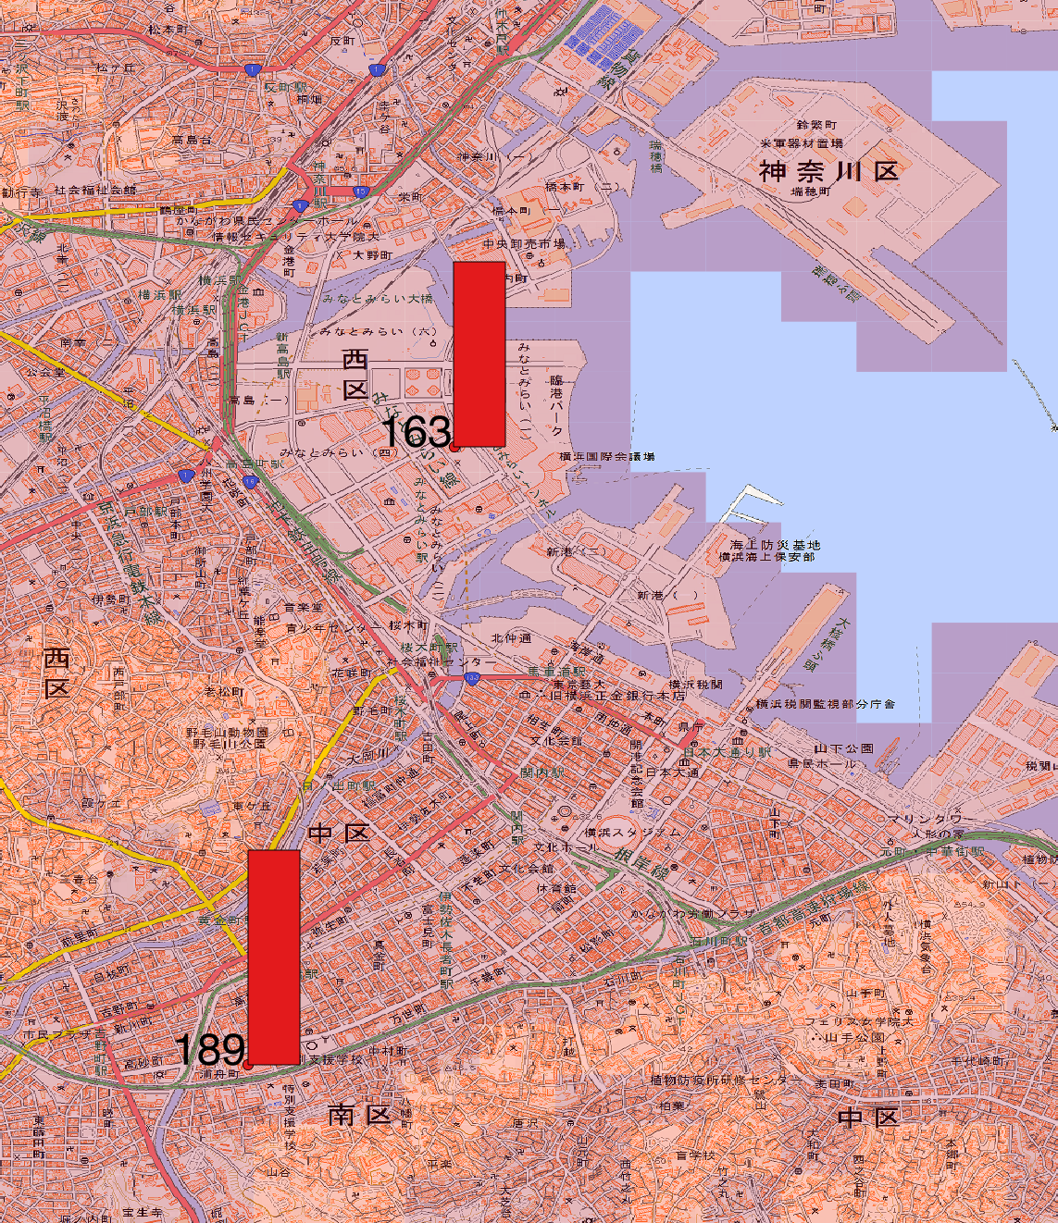
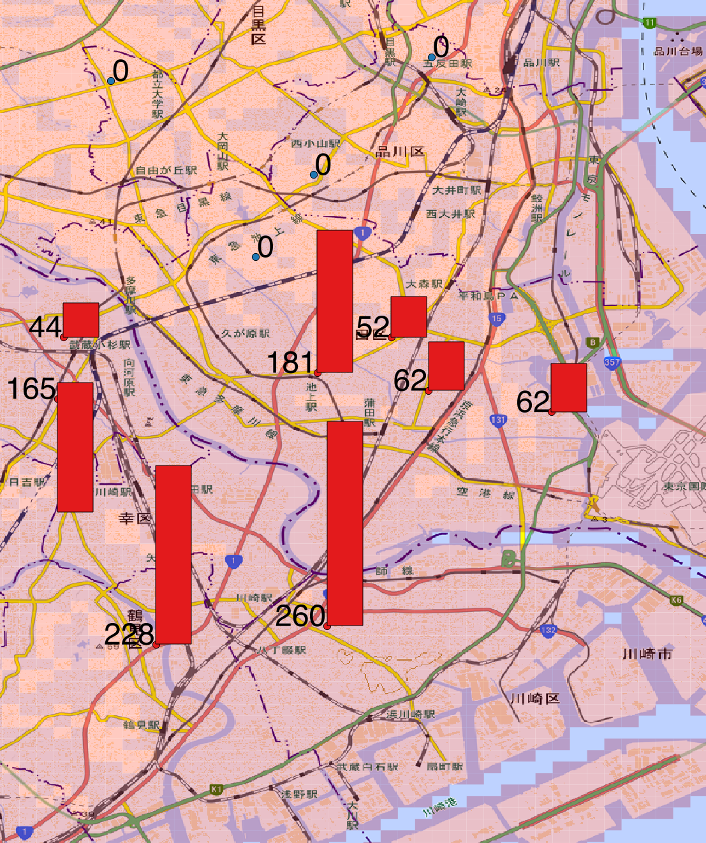
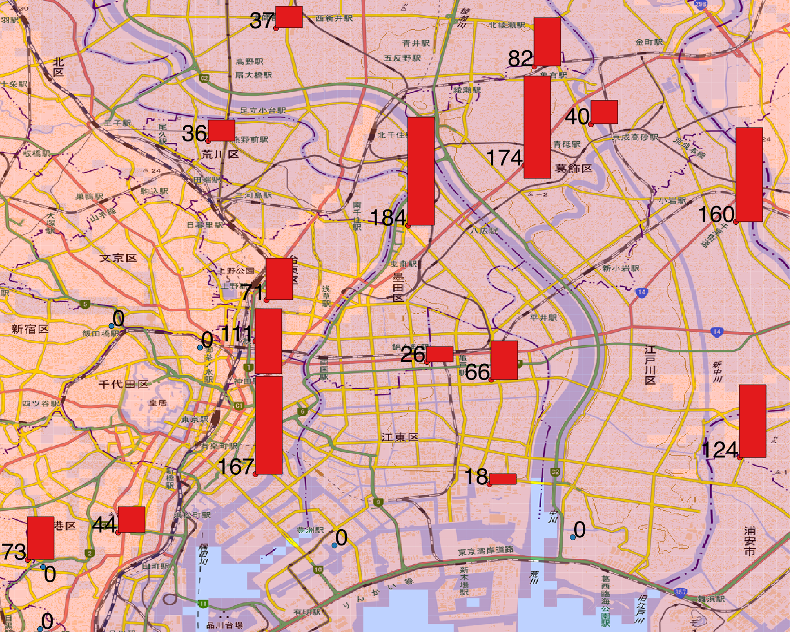
Transport Target Patients Concentrated in the Bay Area
Patients to be transported around Yokohama
352 people
Patients to be transported around Tamagawa River
1,054 people
Patients to be transported around Sumidagawa, Arakawa and Edogawa Rivers
1,413 people
Approx. 67% of patients to be transported (total: 4,218 people)

Slide 12
Consideration for support to the Bay Area
Status of disaster base hospital
Reserve capacity of disaster hospitals (occupancy rate 80%)
Consideration 1
There is a possibility that support from inland can be received because the seismic intensity outside the 23 wards is between 5⁺ and 6⁻(because there is a possibility that the road can be used)
Review 2
There is a possibility that support from the inland can not arrive (the road can not be used) because seismic intensity within the 23 wards is between 6⁻ and 6⁺ (coastal area is 6⁺). In other words, it is necessary to consider support from outside the inland.
→ Approach from Tokyo bay for support
With reserve capacity
Without reserve capacity
Number of patient at disaster base hospital (occupancy rate 89%)
Number of patients to be transported
Approach from the ocean to the patients to be transported concentrated in the bay area
Medical support using medium (or large)size hospital ship on the bay, or small one on the river

Slide 13
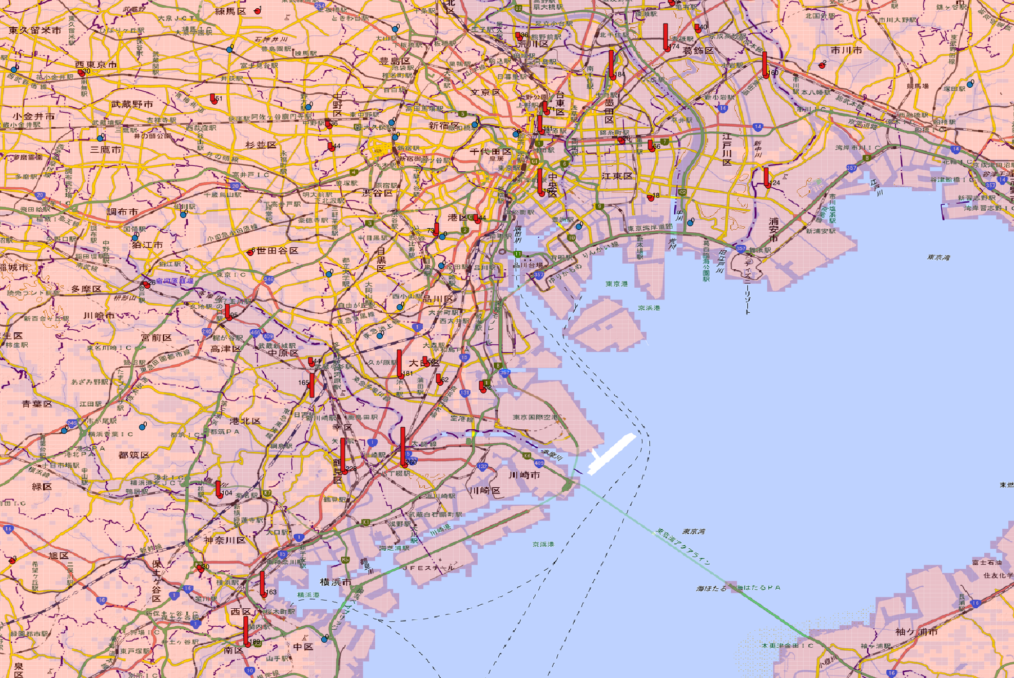
Approach from Sea for the Support 1
Around the
Edogawa
River
By placing large hospital ships on Tokyo Bay
A small ship approaches to each district
By opening temporary medical facilities in each district
By transferring patients who need damage control to a large ship
By transferring backward if necessary
It is important for large ship to equip with not only medical facilities but also equipment's capable of opening temporary medical facilities on land. Medical resources that are lacking are also supplied from large ship. A companion ship carrying temporary medical facilities and patients is necessary.
Around the
Sumida River
Around the
Arakawa
River
Around the Tamagawa
River
Transferring backward
・Ship
・Helicopter, etc.
Hospital
Ship
Yokohama
Bay
Notes:
接岸できない場合or 随伴船が確保できる場合

Slide 14
Approach from Sea for the Support 2
Around the
Edogawa
River
By placing a large hospital ship alongside the pier
By accommodating patients from each district based on a large ship
By opening temporary medical facilities at the pier
By accommodate patients who need damage control in large ship
If damage control is unnecessary, temporary medical facilities will treat
By transferring backward, if necessary
It is important for large ship to equip with not only medical facilities but also equipment's capable of opening temporary medical facilities on land. Means are needed to transport patients from each district.
Around the
Sumida River
Around the
Arakawa
River
Around the Tamagawa
River
Hospital
Ship
Transferring backward
・Ship
・Helicopter, etc.
Yokohama Bay

